Slide 1
Image Processor System Architecture

Slide 2
Requirements and Goal of the System
Functional Requirements
Users should be able to upload images and download processed images.
The System should provide Business Intelligence(BI) on key statistics including number and type of images processed, and by which customers.
The system should save the processed images (min. 7 days) for archival purposes.
Non-functional Requirements
The system should be highly reliable, any images uploaded should not be lost.

Slide 3
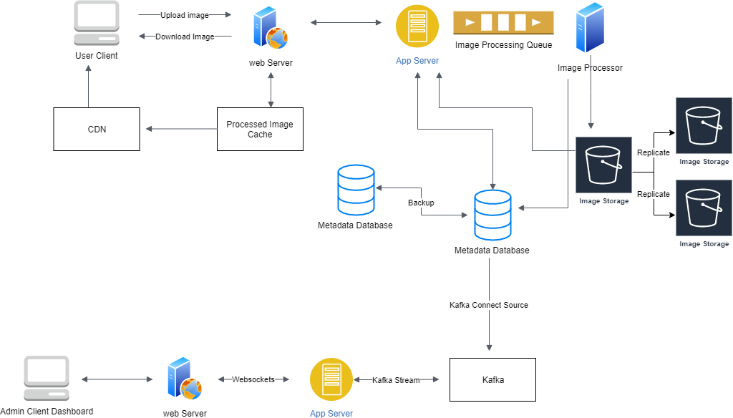
System Architecture Diagram

Slide 4
System Architecture Diagram Components
Processing Queue: Each uploaded picture will be pushed to the processing queue to be processed and saved for storage.
Metadata Database: Contained information on the images uploaded and the user’s information.
Kafka source connector is used to ingest the Metadata Database and stream that data to the App Server. A websocket connection between the Web Server and the App Server allows for real-time updates.

Slide 5
Databases
Choice of DB for metadata – NoSql
Storing large volumes of data that often have little to no data structure.
Ease of scalability like Cassandra which are designed to be scaled across multiple data centers out of the box.
We can store processed photos in a distributed file storage like HDFS or Amazon S3.

Slide 6
Database Schema
We can store the database schema in a distributed key-value store.
Photo
Key: PhotoID
Value: {UserID: int, CreationDate: datetime, Type: str}
User
Key: UserID
Value: {Name: str, Email: str, DateOfBirth: datetime, CreationDate: datetime, LastLogin: datetime}

Slide 7
More on databases
Relationships between user and photo
We can use a column wide datastore like Cassandra.
For the ‘UserPhoto’ Table:
The key would be: ‘UserID’
The value would be: The list of ‘PhotoIDs’ the user owns

Slide 8
Reliability and Redundancy
Cassandra or key-value stores in general, always maintain a certain number of replicas to offer reliability. Also, in such data stores, deletes don’t get applied instantly, data is retained for certain days (to support undeleting) before getting removed from the system permanently.

Slide 9
Reliability and Redundancy
Losing files is not an option. Therefore, we will store multiple copies of each file so that if one storage server dies, we can retrieve the processed photo from the other copy present on a different storage server.

Slide 10
Handling bottlenecks on uploading and downloading images
We could also separate upload and download image requests as uploads (writes) can be slow as they have to go to the disk whereas reads will be faster.
Uploading users can consume all available connections. This means that ‘reads’ cannot be served to the end users if the system gets busy handling write requests.
To handle this bottleneck, we could split reads and writes into separate service with each service having their own dedicated servers.
This will also be easier to scale and optimize each operation independently.

